Slide 1
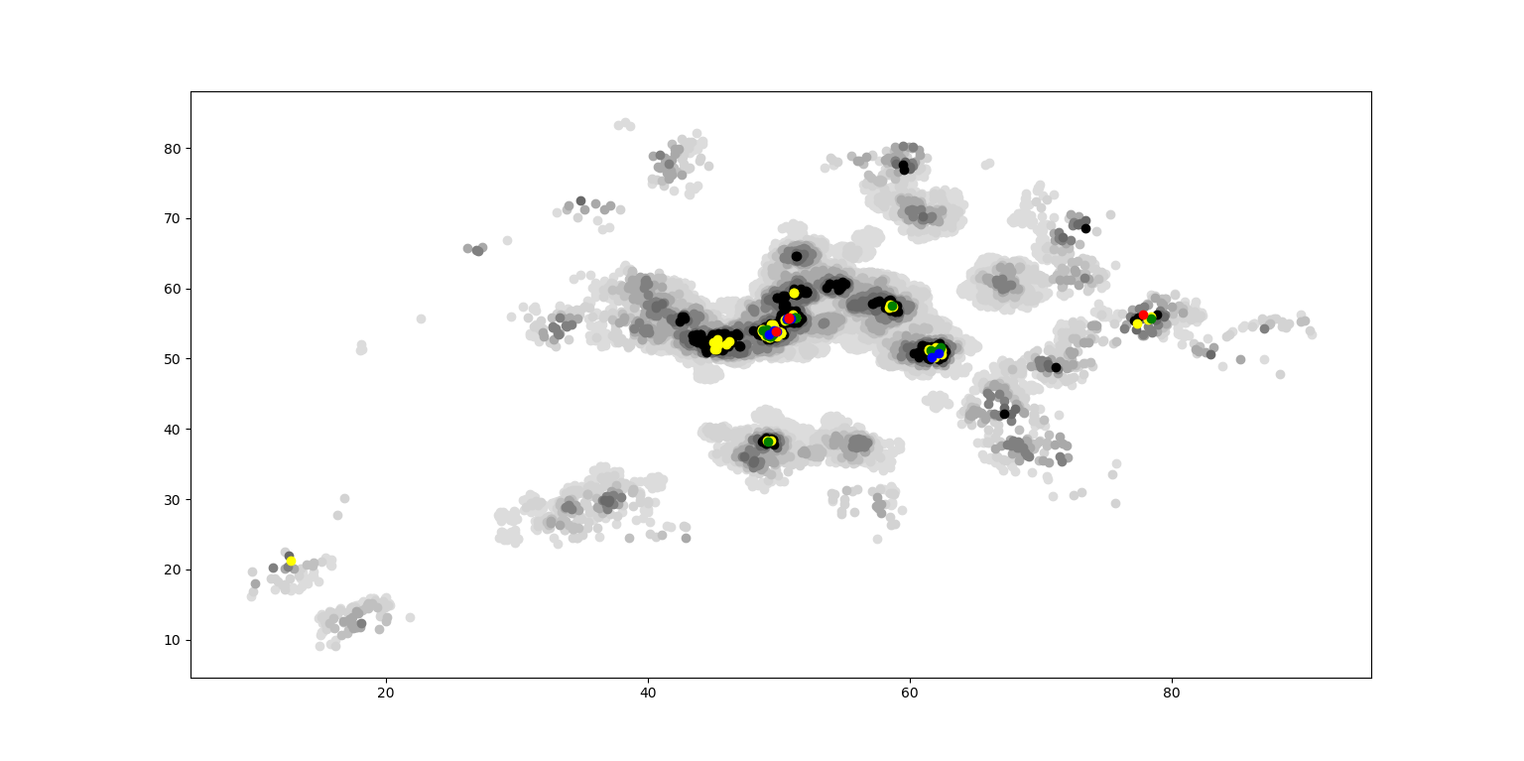
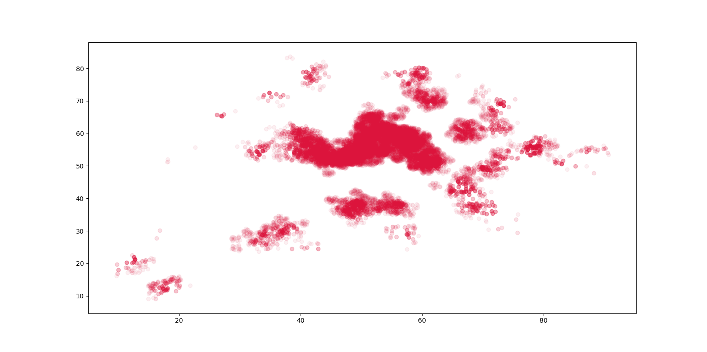
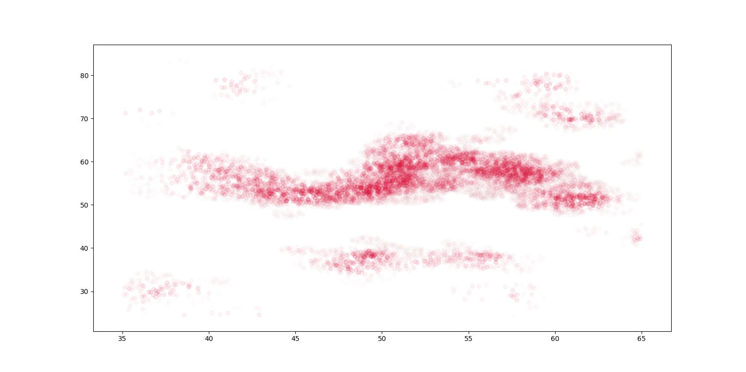
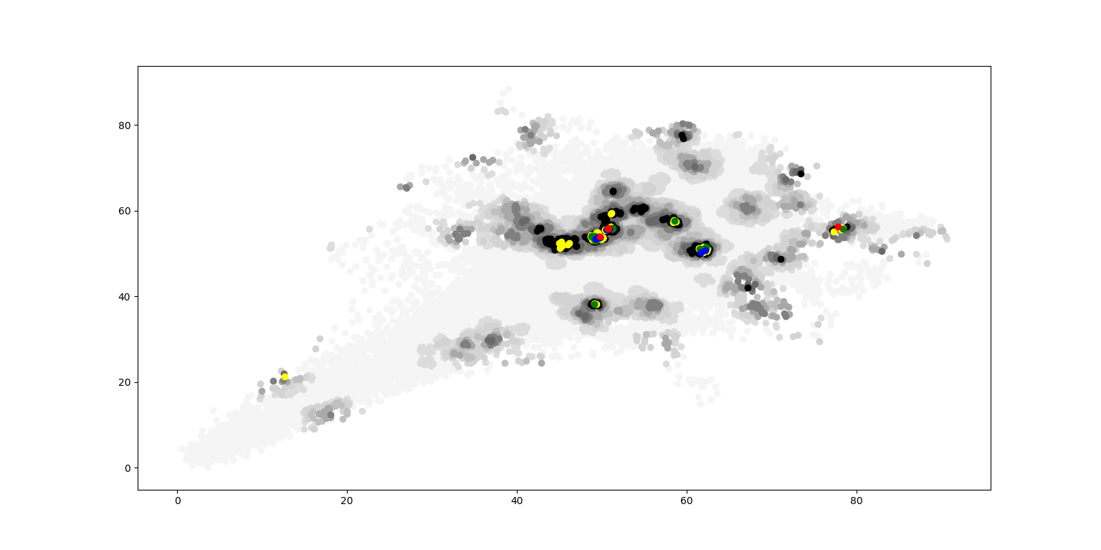
VE414 • Bayesian Analysis
VE414 Project：
Finding Trees Using Hidden Markov Model and Logistic Regression
Team Members: Wenhao Guo, Jiazhen Ji, Jing Dong
Faculty Advisor: Prof. Jing Liu
Problem Statement
In the Forbidden Forrest of Hogwarts, there is a kind of magic tree, known as Jiuling, not only it is always invisible but it has no physical form. This tree can produce a kind of fruit, naming Tayes, that is detectable. From each people in the forest, we have the exact data for each location the number of Tayes close by (less 1 meter away) on the ground and the estimated number of Tayes no far way (less 3 meters away) on the ground from the person. The main task of this project is to find the number of Jiuling in the Forbidden Forrest, and the distribution of Jiuling in the sense of where they are.
Data Analysis
To help us observe data provided, we utilize python to plot graphs which are able to show density of Tayes. In Figure 1, we plot every point where Tayes exits in a circle with radius of 1 m. Different colors represent different number of Tayes. And color representing a greater number of Tayes will cover color representing a smaller number of Tayes.
Fig. 1 Density of Tayes
Another graph uses transparency to express the number of Tayes near a point. As we can see in Figure 2, because of too many Tayes are founded in the center of graph, it is
Fig. 2 Density of Tayes
not clear for us to observe it. So we
plot another graph to focus on the center part.
Fig. 2 Density of Tayes
Fig. 3 Center Part
Modeling and Simulation
Method 1: HMM
The first method concerns the structure of Hidden Markov Model. Basically, the method have two parts. The first part is using the method of Hidden Markov Model to discover the distribution of Tayes. The actual distribution of Tayes is considered as hidden layers and the number of Tayes detected in each location is the observable layer. Using Hidden Markov Model, we can estimate the distribution and the number of Tayes.
The second part is to estimate the distribution and number of Jiuling using the result of the first part. We
can suppose a threshold Tayes and an area of trees. As long as the density in a certain area is larger than the threshold, we can assume that there is a tree in that area.
Method 2: Logistic Regression
The Main idea of this method is to divide the map into a lot of little squares. For each square, there will be a number range from 0 to 1 which presents the proboblity of whether there is a tree. For each row in dataset, the coordinate will be change to a matrix consisting of 0s and 1s. The distance of the cells with number 1 and the coordinate are closer to 1. Then we can use logistic regression with softmax function to optmize the map martix. Which is the distrubition of trees. For getting the total number of trees, we will use cluster to achieve it.
Conclusion
We decide to solve this problem by two methods. We utilize data ’Close’ provided to compute the distribution of Tayes and Jiuling. Then we will use data ‘Far’ to test our model. According to the accuracy of two models, we will select one or combine them together. Finally, we will utilize the final model to predict the area without data recorded and compute the total number of Jiuling in Forbidden Forrest.
Reference
[1] Walker, SH; Duncan, DB (1967). “Estimation of the probability of an event as a function of several independent variables”. Biometrika. 54(1/2): 167-178. doi:10.2307/2333860.JSTOR 2333860.
[2] Menard, Scott W. (2002). Applied Logistic Regression(2nd ed.). SAGE. ISBN 978-0-7619-2208-7

